Slide 1
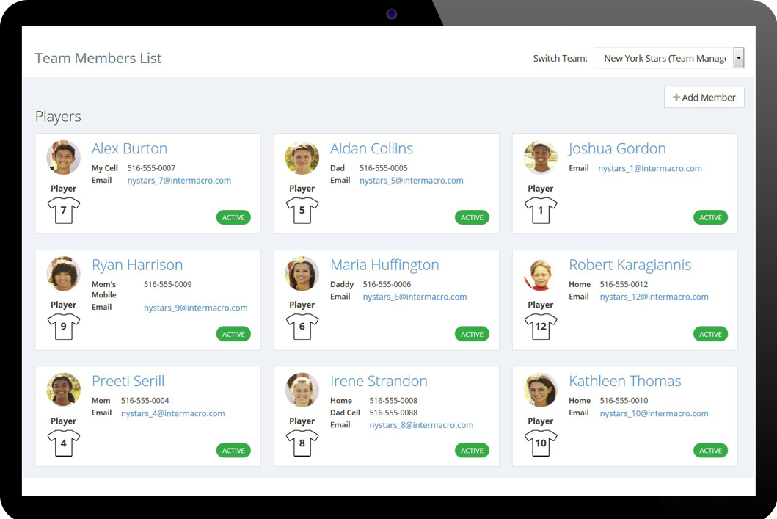
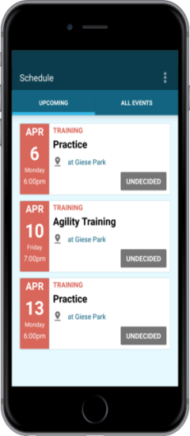


Save Time Managing your Team.
Communicate Better.
We automate the process so you can spend more time on the field.
A Free and Simple Way to Manage Your Sports Team
Created by:

Slide 2

TeamTracky helps with management of your sport team:
  Member List
  Schedule
  Attendance
  Communications
  Payments
  Documents
with an all-in-one, user-friendly solution on desktop and mobile devices.
What is TeamTracky?

Slide 3

TeamTracky can be used by:
  Coaches
  Team Managers
  Players
  Parents
  Trainers
  Club Officials
… or anyone involved
with a sports team.
Who can use it?

Slide 4
  More time coaching, less time managing roster, schedules, attendance and payments.
  Communicate team messages and updates easily and on a timely fashion.
  Import league schedules, opponent teams and field locations is a great time saver.
  Check player attendance for team events and plan accordingly.
  Keep track of team dues and member payments without the use of spreadsheets.
Benefits for Coaches and Team Managers

Slide 5
  Receive email or mobile notifications on time and when needed the most.
  Easy access to team’s schedule, synchronized with other online calendars on desktop or mobile devices (Gmail, Outlook).
  Get field directions with a tap on your mobile device avoiding entering addresses manually.
  Check your balance and payments you made.
Benefits for Players and Parents

Slide 6

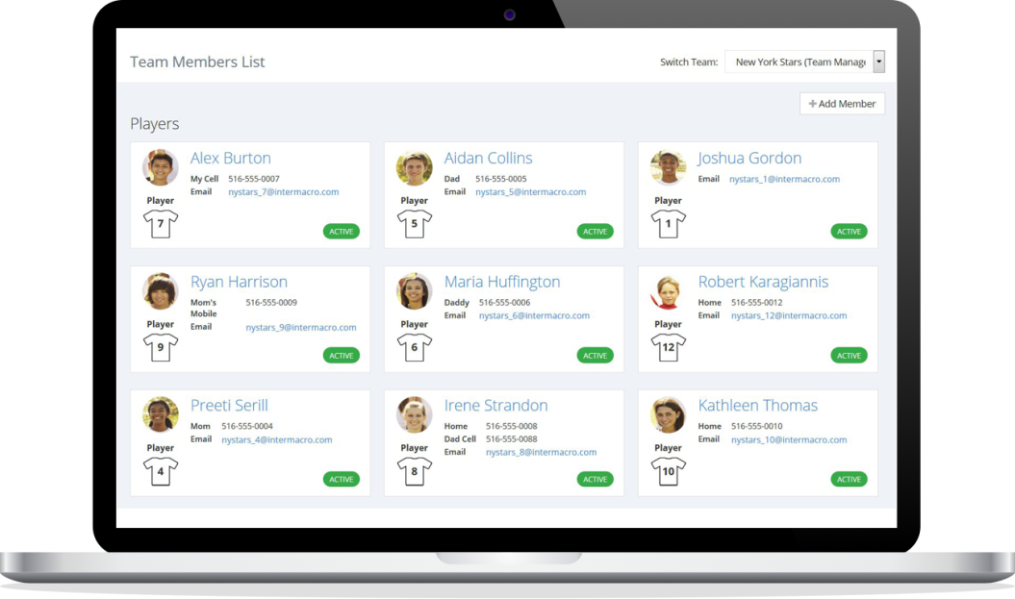
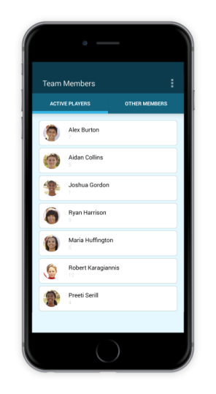
Members
Team members can be coaches, team managers, players, parents, trainers, club officials, etc.
Coaches and team managers can administer roster, member profiles and get all contact information in one place for better communication.
Players and parents can manage their profiles, contact information and communication preferences.
Main Features

Slide 7

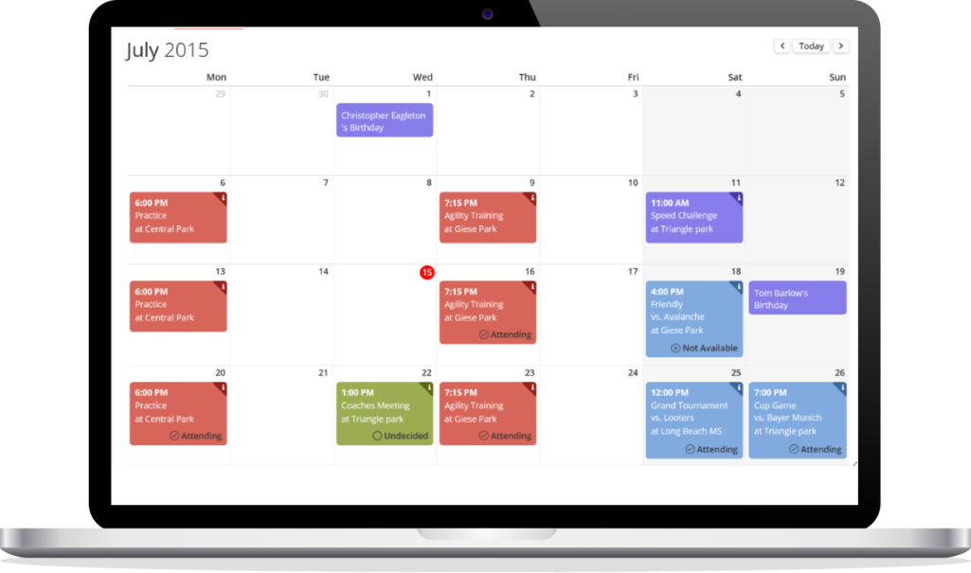
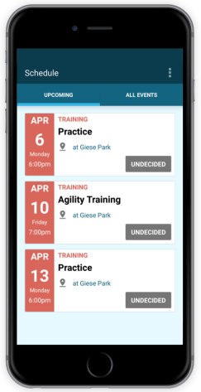
Schedule
Team members and view all events for a single or multiple teams on an easy-to-read calendar and get a full picture of what is coming ahead.
Users can create single or repeating events such as games, practices or meetings, and send notifications to the team members.
Main Features

Slide 8

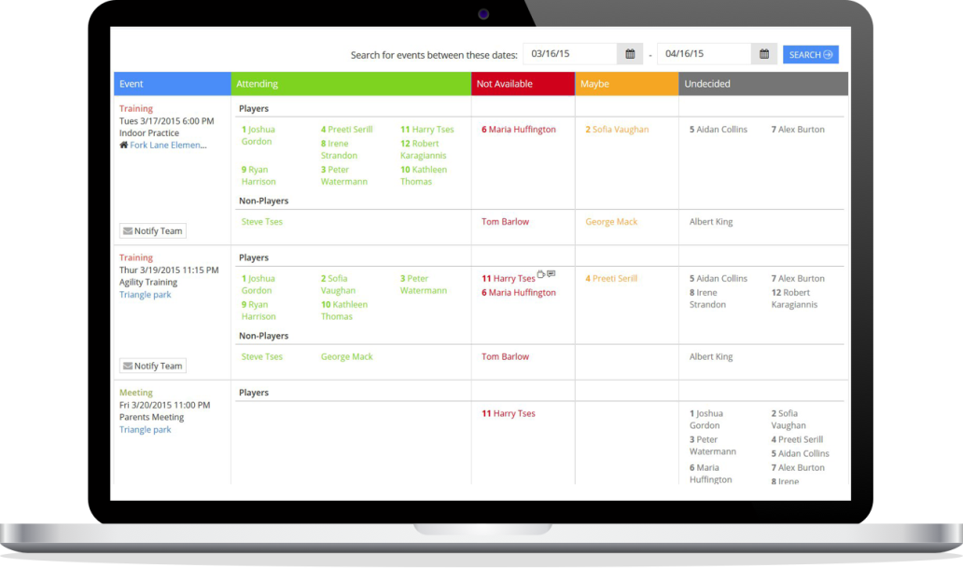
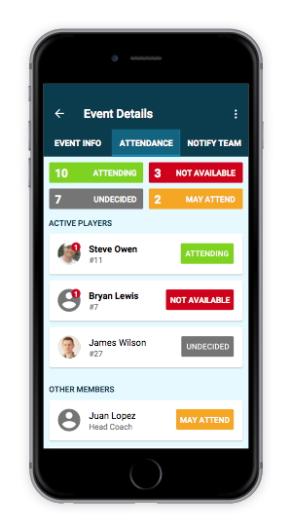
Attendance
Team members can set their availability for events and enter time off dates such as vacations, etc. Coaching staff has a complete picture on who's coming to the next game or practice.
Members set their availability for team events as "attending", "not available", or "maybe".
Main Features

Slide 9

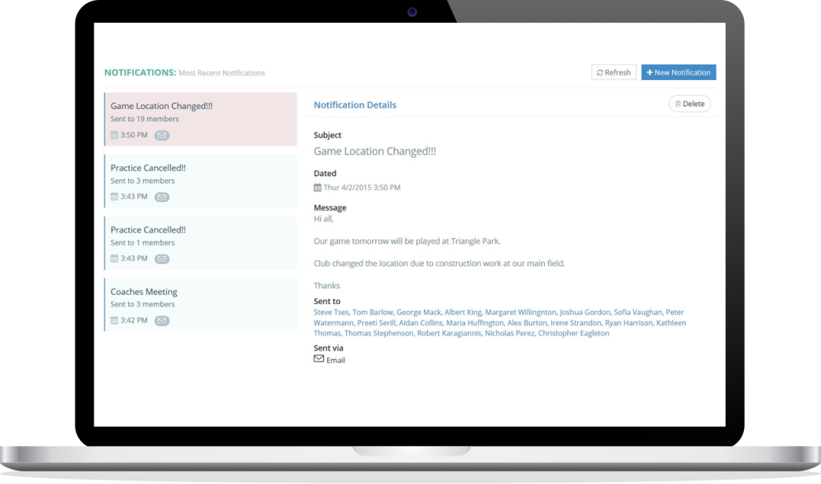
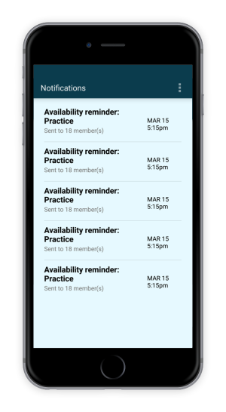
Notifications
Team managers and coaches and send email messages or mobile notifications to team members in seconds to inform them on new events, last minute changes or important team updates.
Coaches can notify the team of last minute changes and members will receive an instant notification on their mobile device.
Main Features

Slide 10

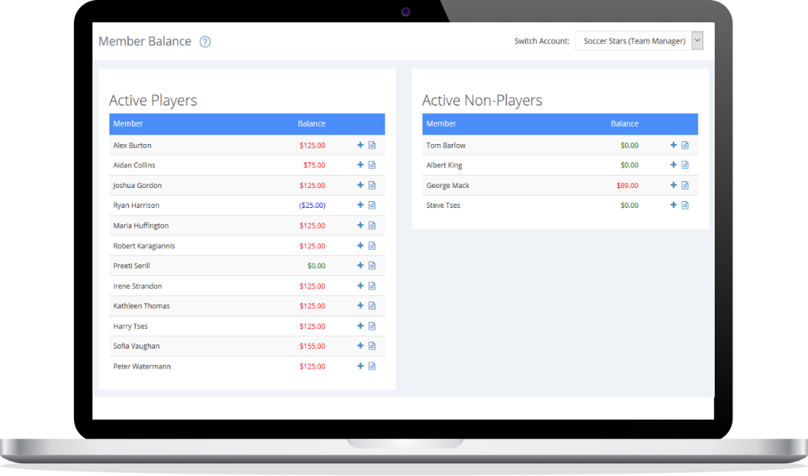
Payments
Easily keep track of team dues and member payments without the use of spreadsheets. Members can check their balance and transaction log.
Record payments you receive from members in seconds and easily keep track of how much each owns.
Members can easily check their
balance and team dues they
have to pay.
Main Features

Slide 11

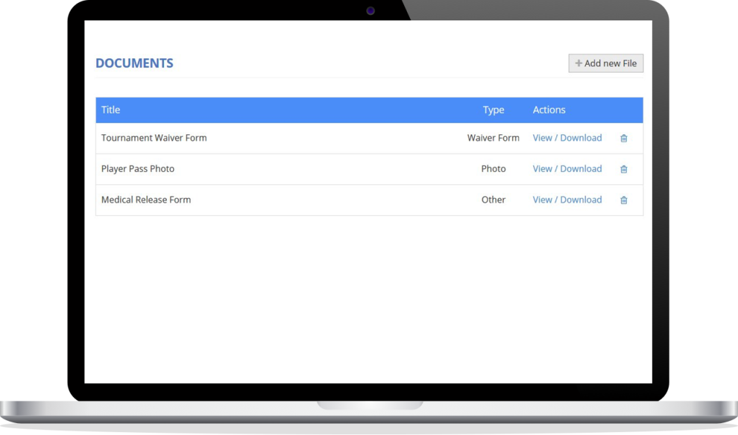
Documents
Securely keep documents needed for team registration such as rosters, waiver forms, photos, etc., in one place.
Members can upload commonly used documents such as roster sheets, birth certificates or waiver forms needed for team registration to tournaments or leagues.
Main Features

Slide 12

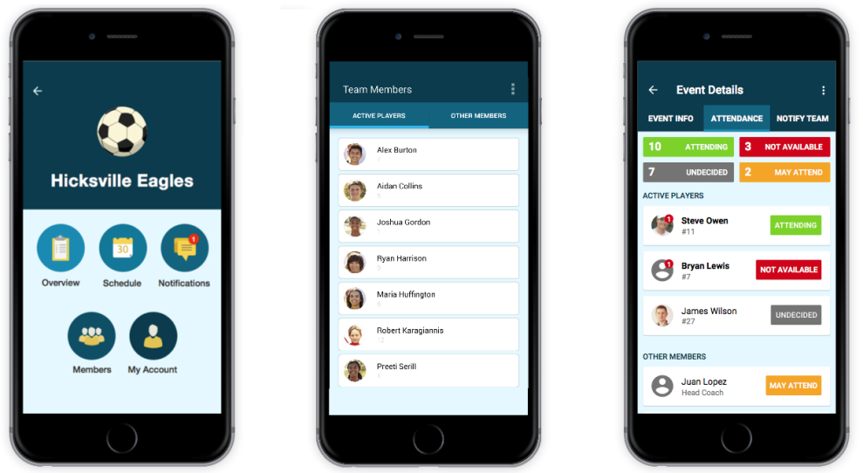
Mobile Apps
TeamTracky mobile app is available on both iOS and Android.
Team members can check schedules, set availability, receive team messages and get field directions on the go.
Coaches can notify the team of last-minute changes, and members will receive an instant notification on their mobile device so they will never miss that "Practice Cancelled" message again.
Main Features

Slide 13
Learn more
Visit our website at www.teamtracky.com
Sign up for FREE at go.teamtracky.com
Get help and Support at help.teamtracky.com
Drop us a line at info@teamtracky.com

